Slide 1
Voice-Controlled Car
- Adhithya Vishwa A

Slide 2
Introduction
This presentation covers the development and functionality of a voice-controlled car leveraging the ESP32-WROOM microcontroller. It highlights the necessary components, software setup, and operational workflow to create a synthetic environment for remote control through voice commands. The project aims to provide insight into Speech-Recoginition applications of AI.

Slide 3
01
Project Overview

Slide 4
Voice-Controlled car concept
This project involves building a car that can be controlled with voice commands. Using the ESP32, users can send commands through a web interface, allowing for hands-free operation. This innovation combines aspects of robotics, IoT, Speech-Recoginition and user interface design to create an engaging project.

Slide 5
ESP32 integrated features
The ESP32 microcontroller serves as the core of this project, enabling WiFi functionality and motor control via PWM. Built-in support for MicroPython allows for rapid development, while its ability to function as a WiFi access point simplifies the setup process. The car leverages these features to execute commands received through a web browser, demonstrating robust Internet of Things capabilities.

Slide 6
Web interface commands
The web interface allows users to input voice commands to control the car remotely. It functions as a user-friendly platform accessible via a standard web browser. Upon connecting to the ESP32 WiFi, users navigate to a predefined IP address and are presented with command options such as 'Forward,' 'Left,' 'Right,' and 'Stop.' The integration of Speech-Recoginition facilitates seamless interactions, making it an intuitive user experience. This component highlights the practical application of AI & IoT in providing real-time control of physical devices over the internet.

Slide 7
02
Hardware Components

Slide 8
ESP32-WROOM board & accessories
The ESP32-WROOM board is a powerful microcontroller featuring integrated WiFi and Bluetooth capabilities. It serves as the brain of the voice-controlled car, enabling wireless communication and control. Accompanying accessories include jumper wires for connections, a micro USB cable for programming, and necessary sensors if desired. Its versatility allows for the integration of additional functionalities such as obstacle detection or enhanced motor control, making it suitable for numerous IoT applications.

Slide 9
Motor driver and battery specifications
The L298N motor driver is essential for managing the DC motors in the car. This dual H-bridge driver allows for the control of both direction and speed using PWM signals from the ESP32. A 7.4V LiPo battery provides the necessary power to operate the motors and microcontroller efficiently. Proper management of battery charging and connections for safe operation is critical to ensure the longevity and reliability of the car's performance.

Slide 10
Required wiring and chassis
The wiring setup involves connecting the ESP32 GPIO pins to the inputs of the L298N motor drivers. The outputs of these drivers are then linked to the DC motors for movement control. Additionally, the battery's positive and negative terminals connect to the motor driver to provide power. The chassis must be sturdy enough to support the weight of the components and allow for effective gear assembly, ensuring that the car operates smoothly and without mishaps during movement.

Slide 11
Conclusions
In summary, the voice-controlled car utilizing the ESP32 exemplifies a practical application of Speech-Recoginition technology in robotics. It showcases the integration of hardware components like the ESP32 and motor drivers, enabling voice command functionality through a web interface.

Slide 12
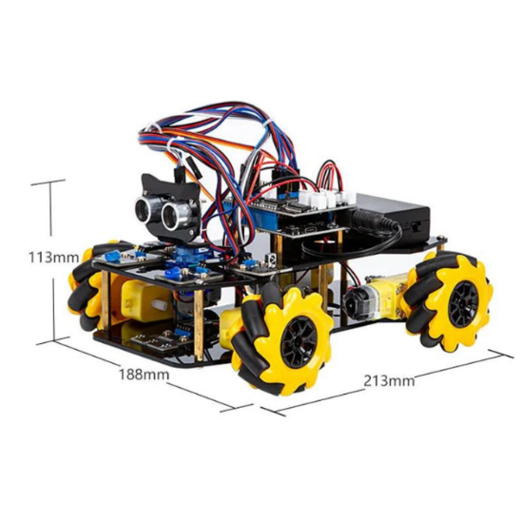




Thank you!

